Slide 1
Information and Computation
Lecture 1
Joint entropy, conditional entropy and mutual information

Slide 2
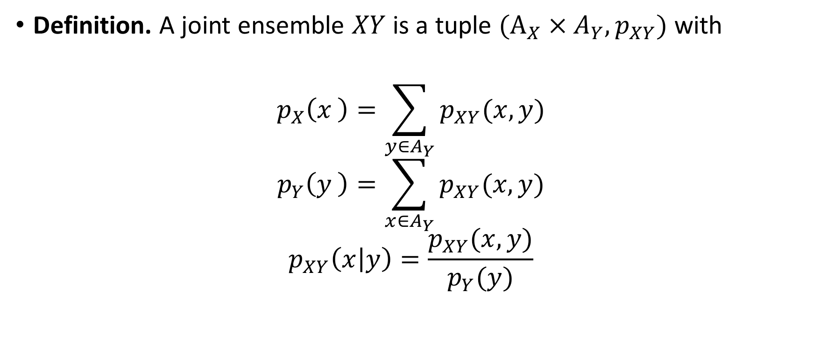
A probability refresher
Definition. A joint ensemble $XY$ is a tuple $(A_{X}×A_{Y},p_{XY})$ with
$$p_{X}\left(x \right)=\sum_{y∈A_{Y}}{p_{XY}(x,y)}$$
$$p_{Y}\left(y \right)=\sum_{x∈A_{Y}}{p_{XY}(x,y)}$$
$$p_{XY}\left(x | y\right)=\frac{p_{XY}(x,y)}{p_{Y}(y)}$$

Slide 3
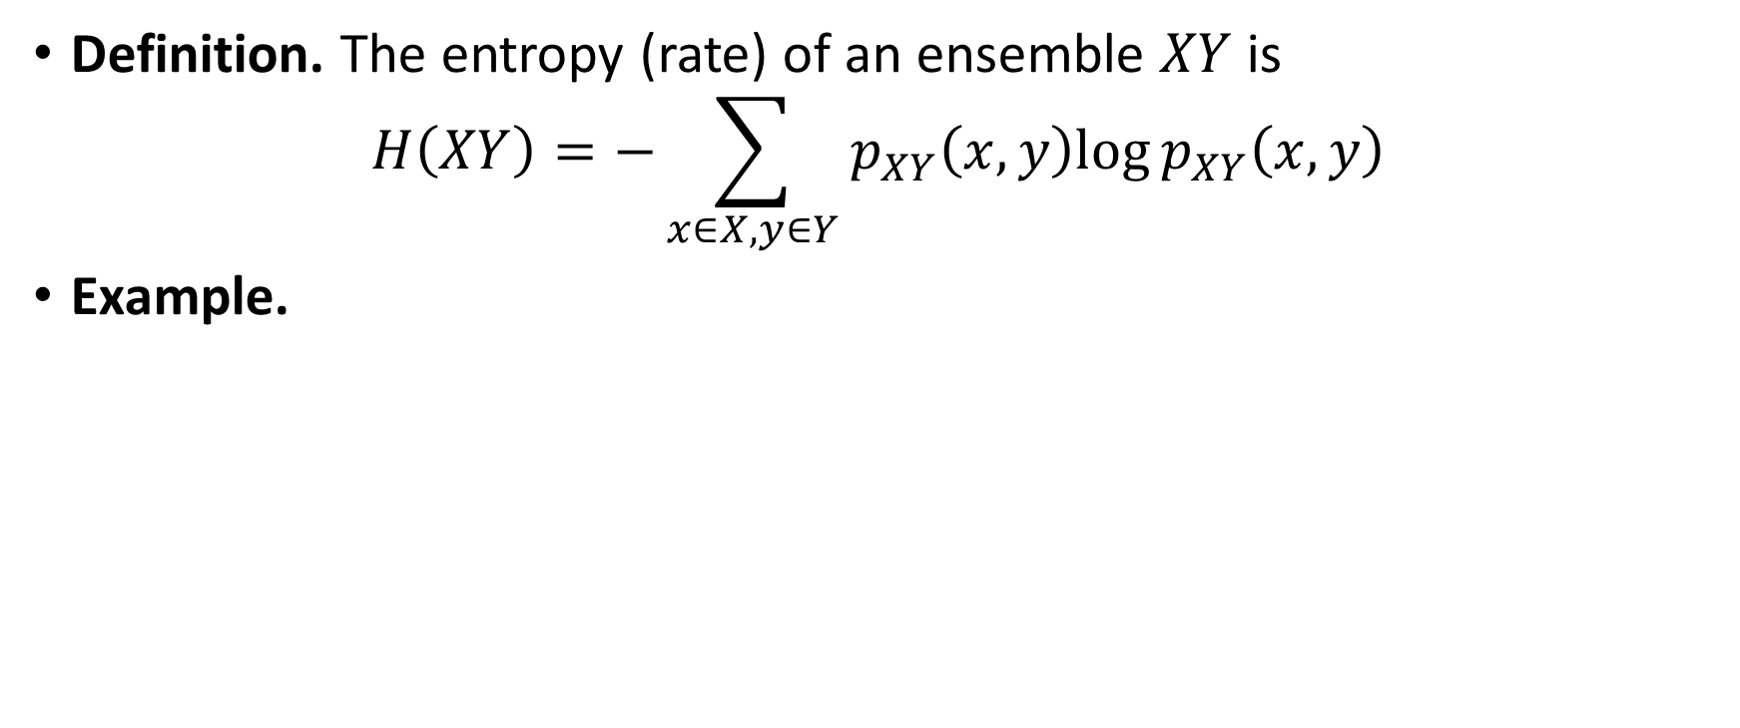


Joint entropy
Definition. The entropy (rate) of an ensemble $XY$ is
$$H\left(XY\right)=−\sum_{x∈X,y∈Y}{p_{XY}\left(x,y\right)log⁡p_{XY}\left(x,y\right)}$$
Example.

Slide 4
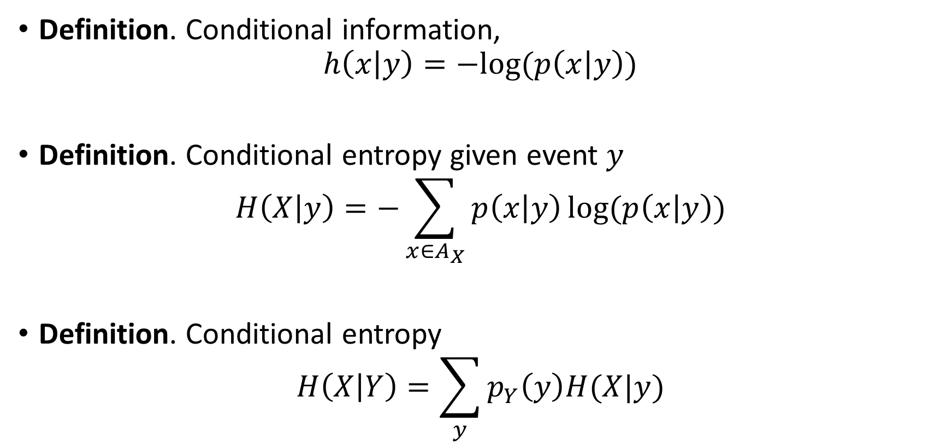
Conditional entropy
Definition. Conditional information,
$$h\left(x | y\right)=−log⁡(p\left(x | y\right))$$
Definition. Conditional entropy given event $y$
$$H\left(X | y\right)=−\sum_{x∈A_{X}}{p\left(x | y\right)}log⁡(p\left(x | y\right))$$
Definition. Conditional entropy
$$H\left(X | Y\right)=\sum_{y}{p_{Y}\left(y\right)H(X|y)}$$

Slide 5
 | Days with no rain | Days with rain
Rotterdam | 212 | 153
Atacama desert | 360 | 5
Exercise 1.1 - Let us assume that you are living in the Atacama desert where it rarely rains. How much information do the messages 0 and 1 carry?

Slide 6
 | Days with no rain | Days with rain
Rotterdam | 212 | 153
Atacama desert | 360 | 5
Exercise 1.1 - Let us assume that you are living in the Atacama desert where it rarely rains. You receive a 0. How much information does this message carry?
Exercise 1.2 - Now let us assume that you live in the Netherlands where it does rain quite often, but certainly not every day. How much information do the messages 0 and 1 carry?

Slide 7
 | Days with no rain | Days with rain
Summer | 182 | 1
Winter | 30 | 152
Exercise 1.1 - Let us assume that you are living in the Atacama desert where it rarely rains. You receive a 0. How much information does this message carry?
Exercise 1.2 - Now let us assume that you live in the Netherlands where it does rain quite often, but certainly not every day. You receive a 0. Does the message contain information?
Exercise 1.3 - Finally, let us assume that you live in the Netherlands but (boldly) also that you are aware of the current season. You receive a 0. Does the message 0 carry the same information in summer and in winter?

Slide 8
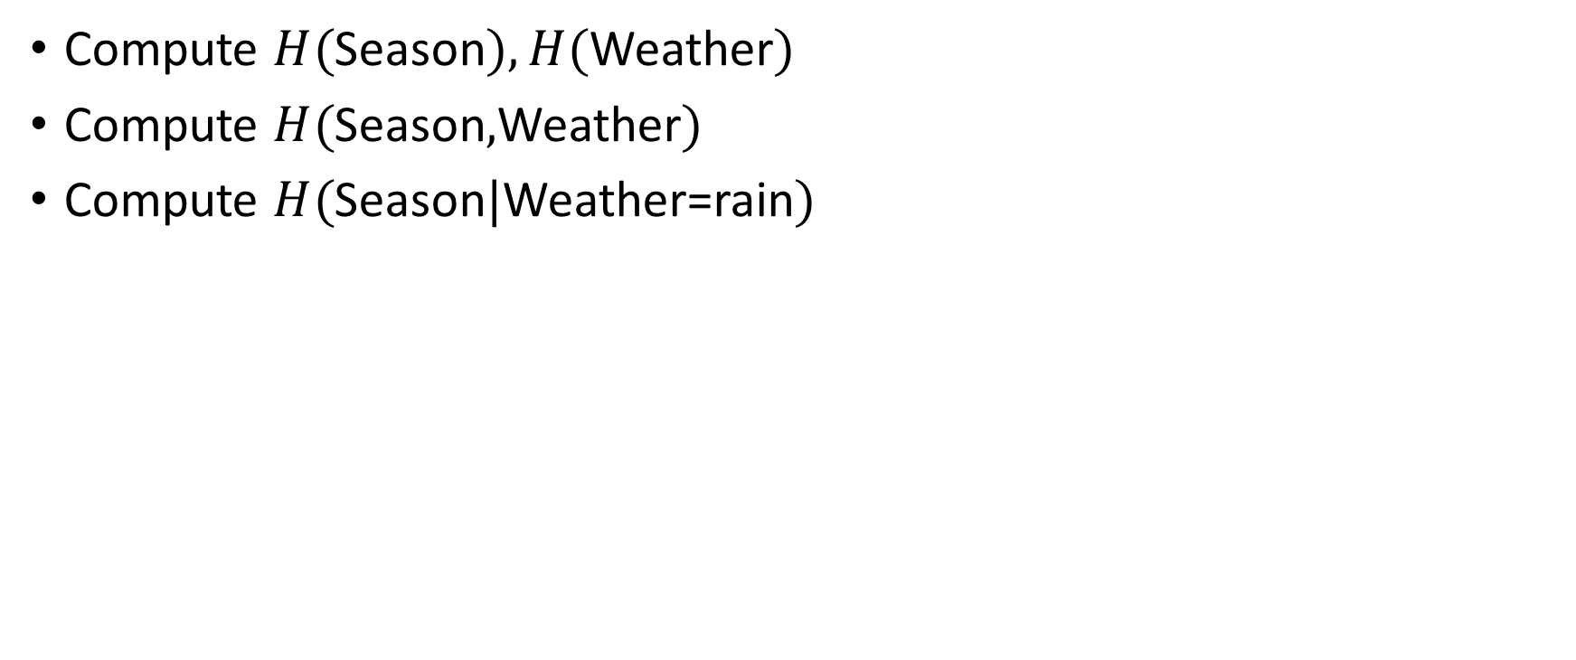
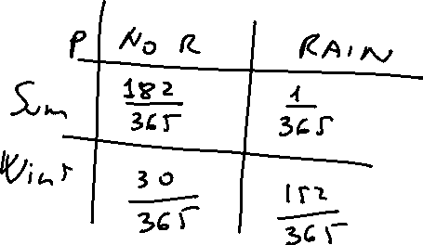
 | Days with no rain | Days with rain
Summer | 182 | 1
Winter | 30 | 152
Compute $H($Season$),H($Weather$)$
Compute $H($Season$,$Weather$)$
Compute $H($Season$|$Weather=rain$)$

Slide 9
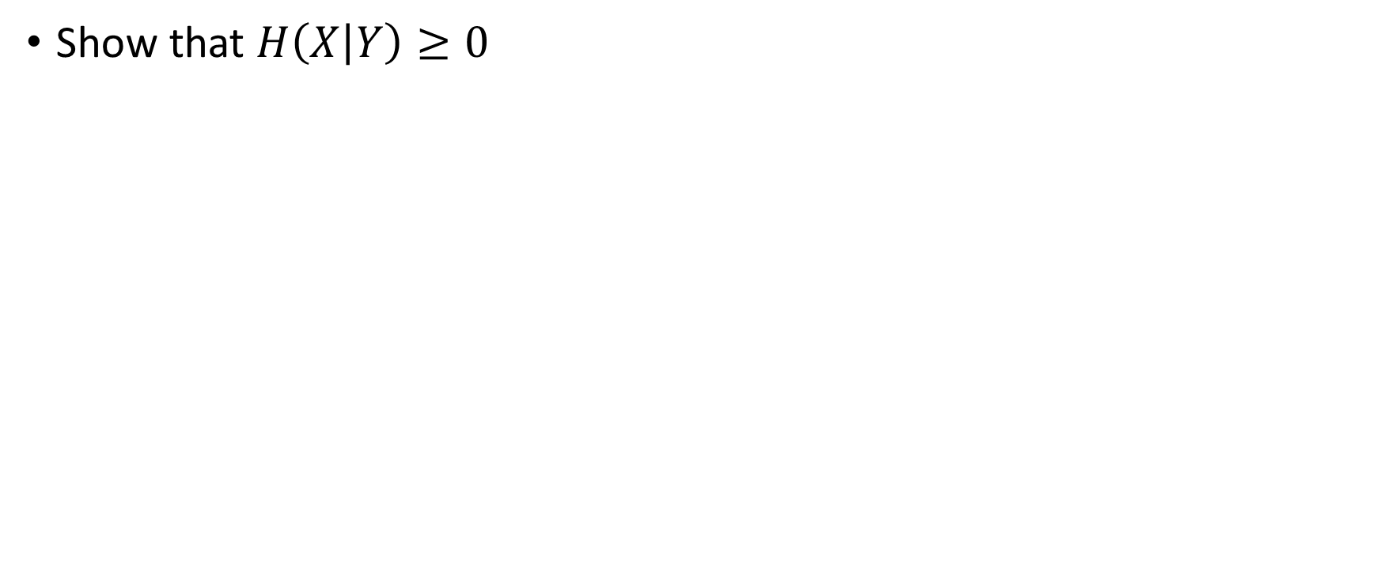
Exercise
Show that $H\left(X | Y\right)≥0$
Notes:
Average of entropies

Slide 10
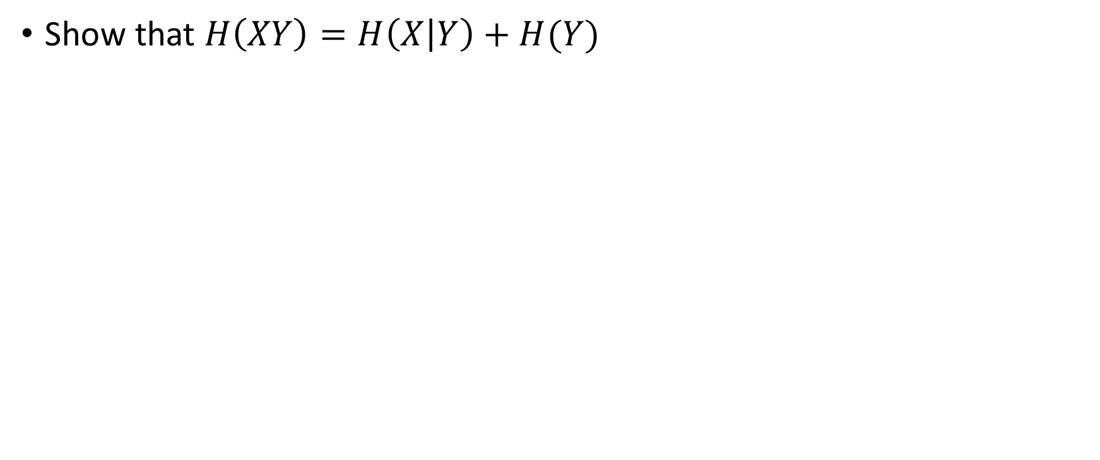
Exercise. Chain rule
Show that $H\left(XY\right)=H\left(X | Y\right)+H(Y)$
Notes:
Expand from the right

Slide 11
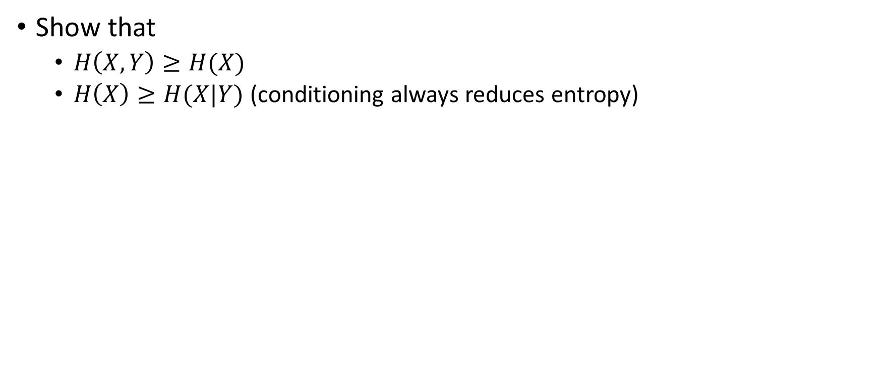
Exercise
Show that
  $H\left(X,Y\right)≥H(X)$
  $H\left(X\right)≥H(X|Y)$ (conditioning always reduces entropy)
Notes:
Chain rule
Expand right, apply Jensen’s inequality

Slide 12
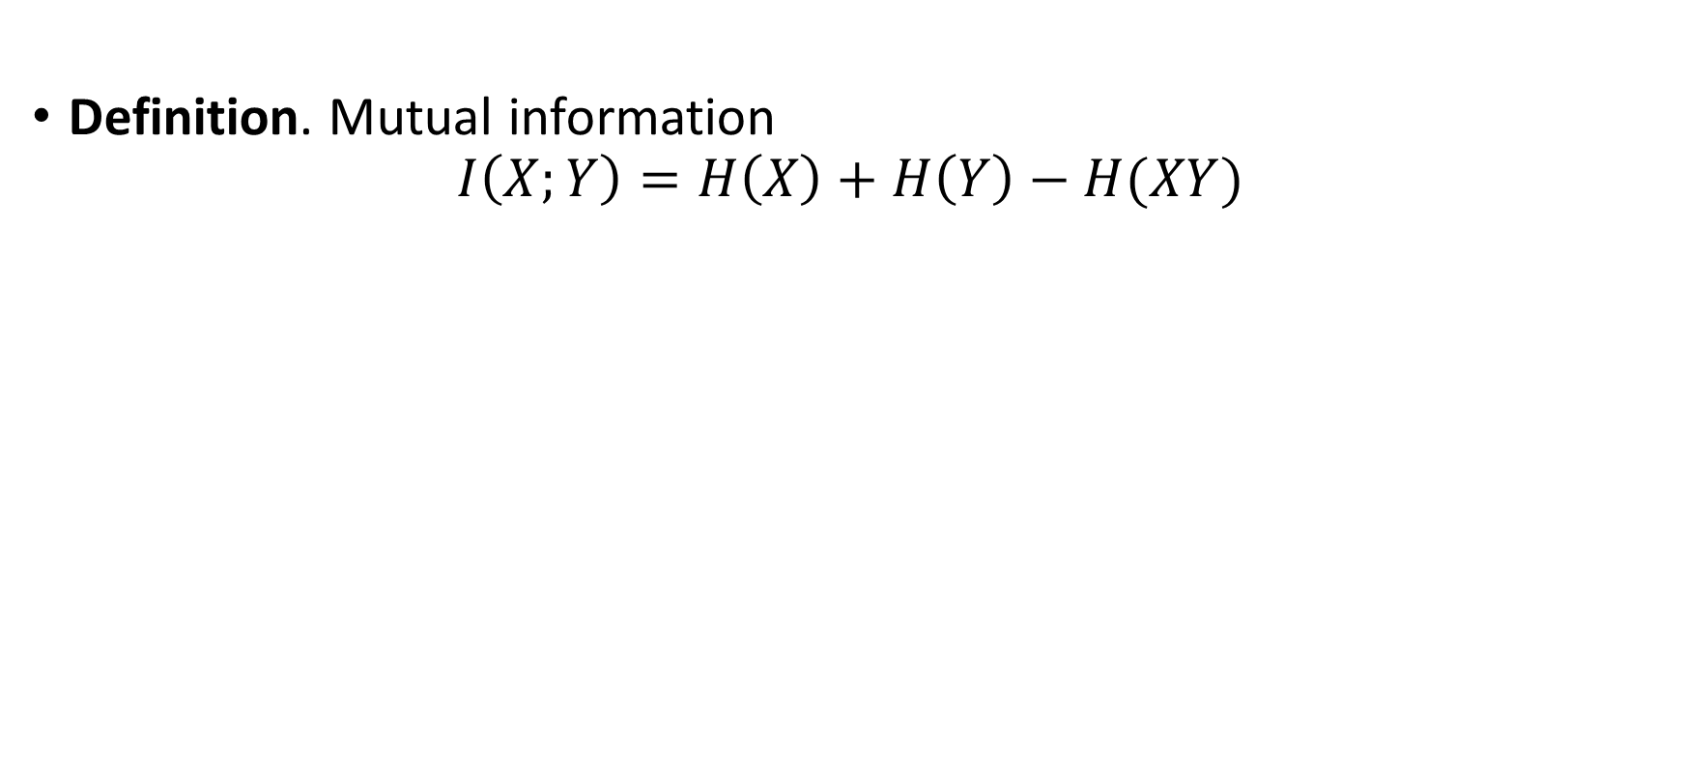
Mutual information
Definition. Mutual information
$$I\left(X;Y\right)=H\left(X\right)+H\left(Y\right)−H(XY)$$

Slide 13
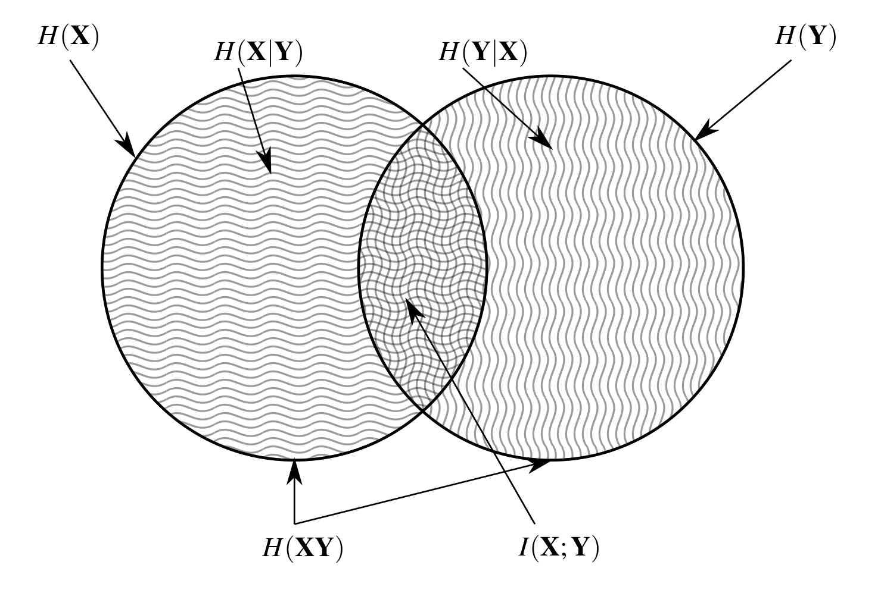

Slide 14
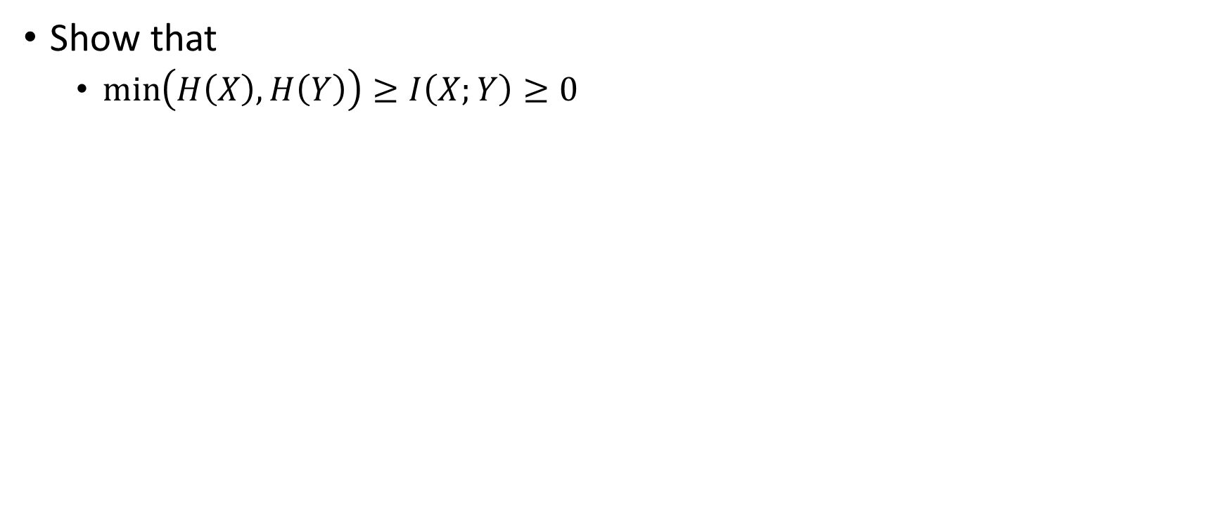
Exercise
Show that
  $\min\left(H\left(X\right),H\left(Y\right)\right)≥I\left(X;Y\right)≥0$
Notes:
Right from conditioning
Left, expand H(X)-I(X;Y)

Slide 15




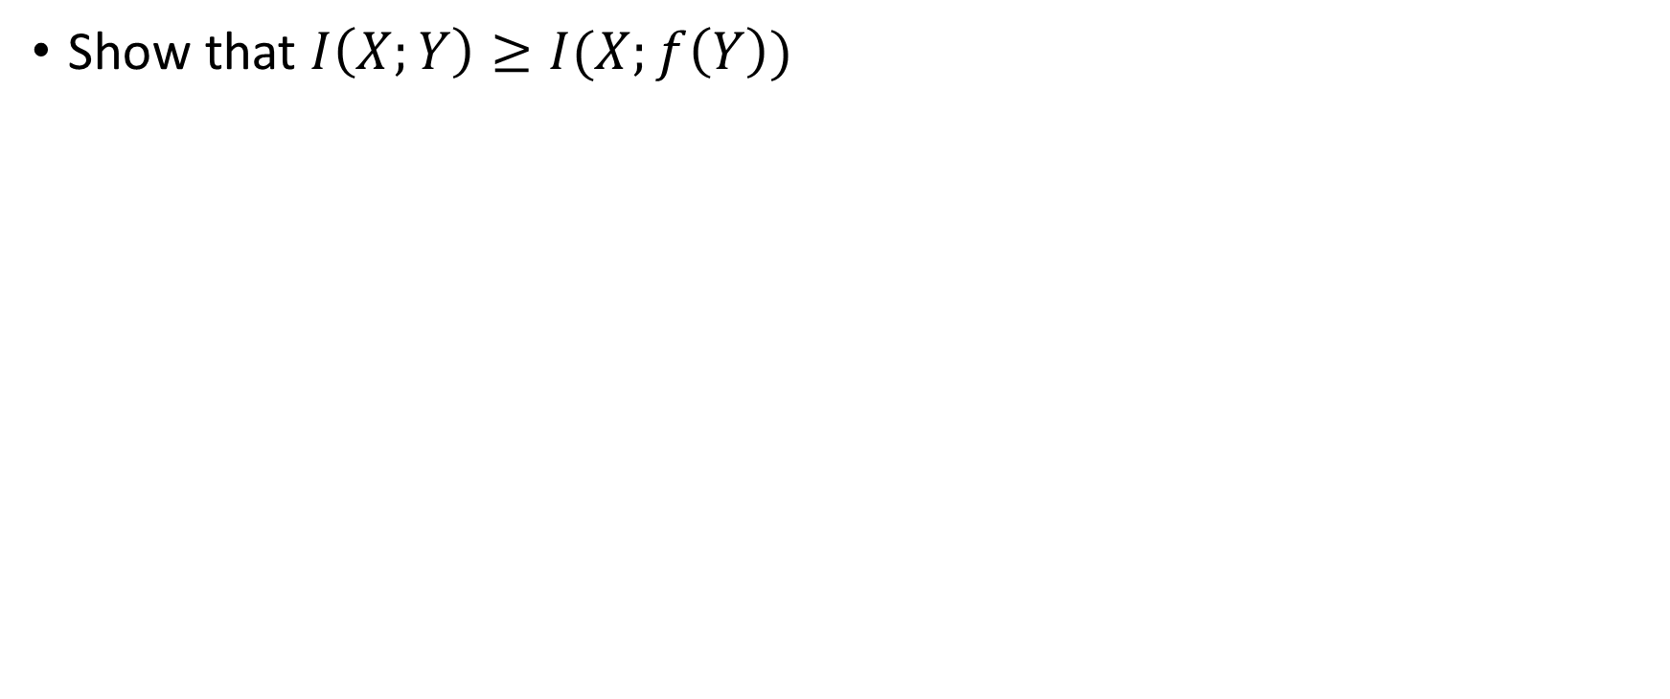




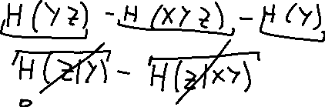










Data processing inequality
Show that $I\left(X;Y\right)≥I(X;f\left(Y\right))$
Notes:
Expand I(X;YZ) with Z=f(Y)

Slide 16






















Slide 17
You will do great in the exam if you can
Evaluate entropy, conditional entropy and mutual information
Derive basic properties of the above

Slide 18
Resources
Lecture notes
Slides
“Elements of information theory”. Cover and Thomas. Chapter 2.1-2.8
“Information Theory, Inference, and Learning Algorithms”. MacKay. Chapter 2

